Slide 1
Instructions for Visualization and Analysis Demos
You have 3 minutes to present – be ready to share your screen, practice first. We can only offer you one opportunity to present. Present your slides in “Slide Show” mode. Presentations will take place during the module Tutorial slots (see Announcements for links to join the Tutorials via Teams).
The next few slides give you all the alternatives for how to present your Visualizations. You will select only one as fits your RQ. Before presenting DELETE all text (and instructions) that you do not use (including this slide). You can then enlarge your selection, so it is clearly visible on the slide.
Appointment slots will appear on Canvas soon (calendar-7com1079-24). Sign up early. When space runs out, we cannot issue any further slots for this week. If you do not turn up for your slot you will not be given another opportunity. Ideally, all the group members should attend but select one person to present. DO NOT SIGN UP unless once of your group can attend and present. You will not be graded on this.
We look forward to giving you feedback. If your group is not presenting, still attend the tutorial as the feedback will help you too.
At this point we assume you are using your allocated datasets (see RQ coursework spec). Any changes to the Kaggle.Data.world csv/xlxs file you make such as merges, grouping, or size reduction must be done via an R script, not manually, not in excel.

Slide 2

Visualization and Analysis – Tutorial Presentation for Feedback Date:
Group Id: Name of Student Presenting:

Slide 3
If you have not defined your Research Question (RQ) yet, please do not attempt to present Visualisations and/or analyses of your data. Go to Canvas, announcements on RQ presentations, and use the PowerPoint template provided for you to present your RQ. You can use the time slot to present your RQ instead of the Visualisation.
Part 1: VISUALISATION

Slide 4
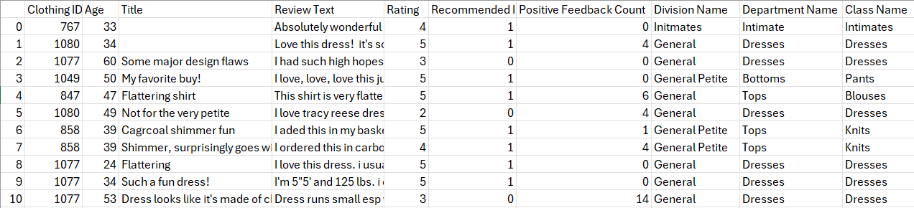
We are using the dataset DS147- Womens Clothing E-Commerce Reviews to answer our Research Question “Is there a correlation between rating and age in Womens Clothing E-Commerce Reviews ”
The dataset has 23486 rows
The dependent variable is Rating
The independent variable is Age

Slide 5
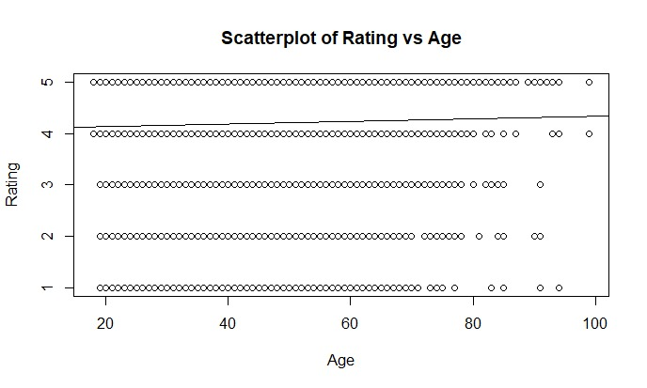
Part 1: VISUALISATION
Scatterplot

Slide 6
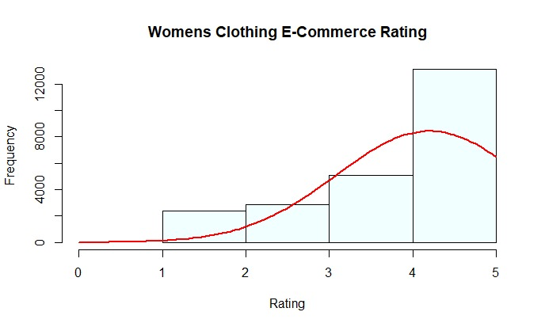
Part 1: VISUALISATION
Histogram

Slide 7
Here is a Histogram showing the frequencies of our dependent variable to include the normal curve overlay.
Our RQ asks about Correlation
:
The normal curve overlay does not follow the shape of the underlying data, so for our analysis we use the non-parametric test for correlation that does not assume normality: Spearman’s Rho or Kendal’s Tau.
7
Notes:
7

Slide 8
Only attempt this Analysis part of the demo if you have completed your Visualization(s). Otherwise end your demo after the Visualization for feedback.
Part 2: Analysis (building on your Visualizations)

Slide 9
R Script and Results (For ALL types of test) – The Analysis
PRE 7COM1079-2022 Student Group No: ?????
9
Include a snippet of the R code you use to calculate your test statistic.
Give the value of the test statistic.
Tell us the p-value. Is it > or < 0.05?
Is the result significant?
Do you accept or reject the null hypothesis?
What does the result actually mean in the wider context of learning something useful / answering your RQ?
Notes:
9

